Slide 1
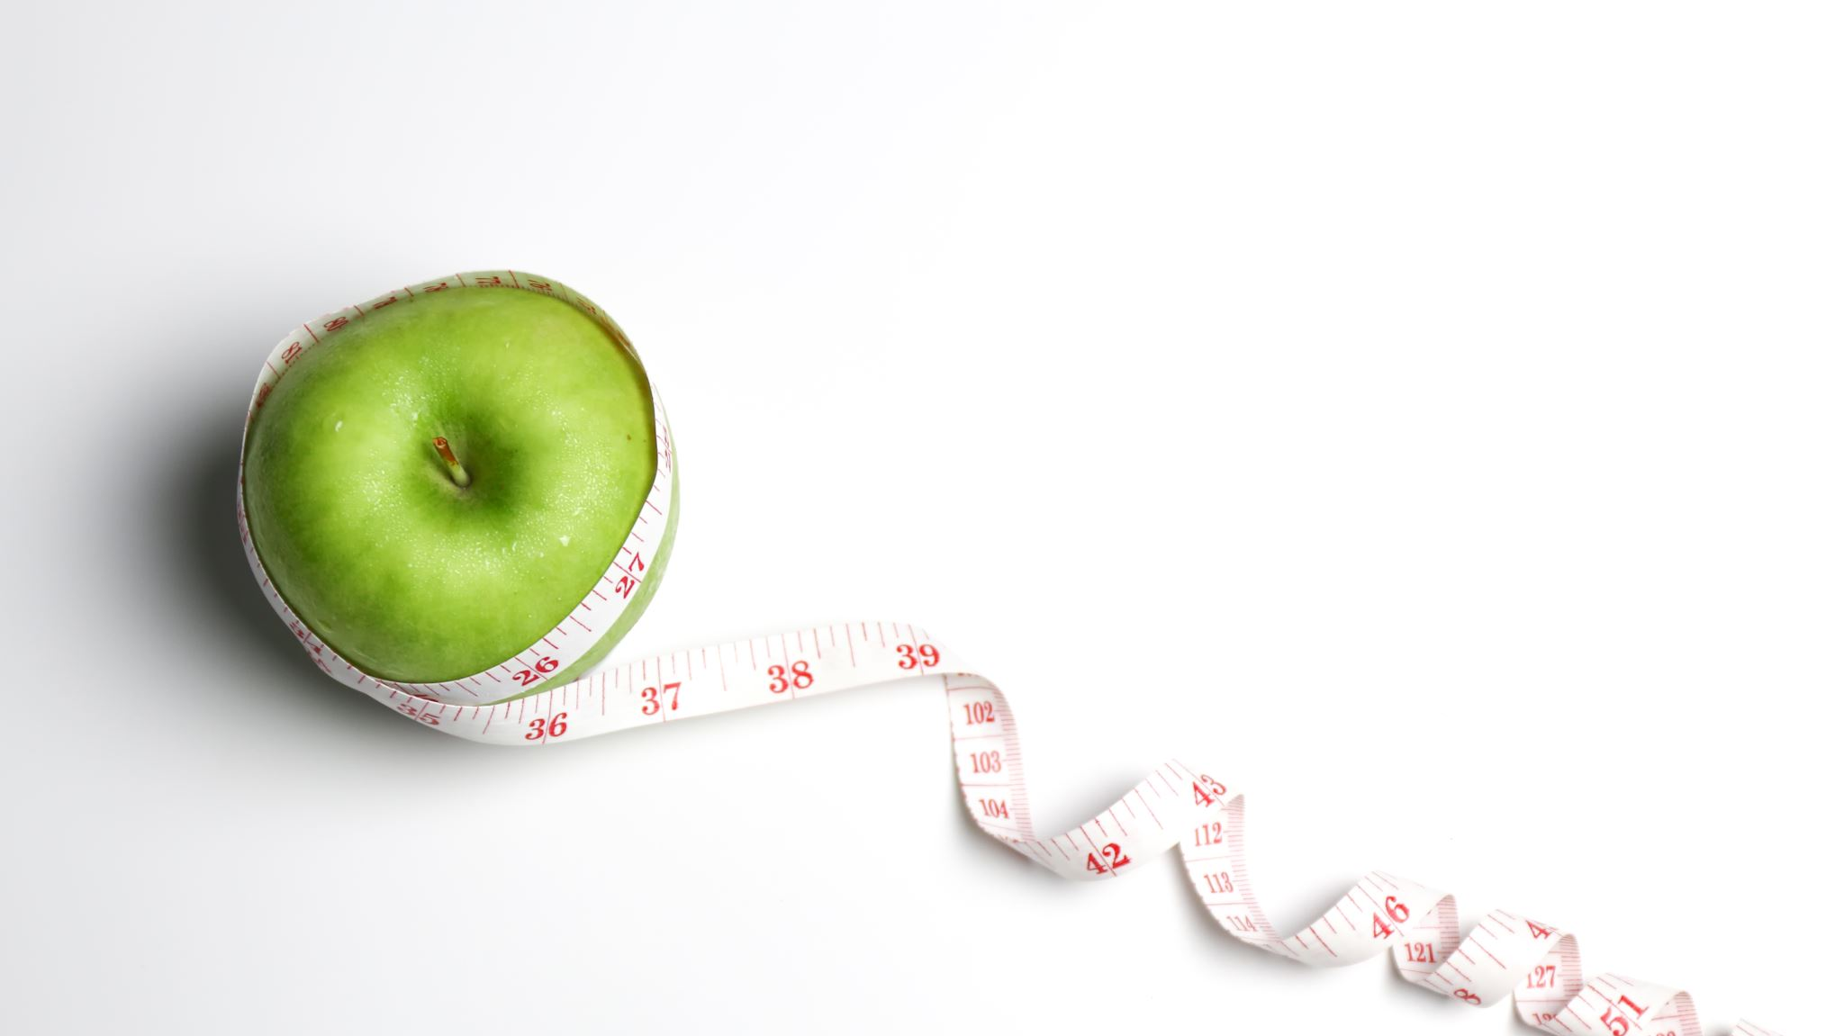
Healthy Eating App Plan
For School Children Aged 4-16
By Ethan D

Slide 2
Quick Brief
An information / multimedia app must have at least six separate pages, three types of media (text, images, animations, audio or video) and should be easy to navigate through these pages.
There must be at least 2 sketches or wireframes of how the app will look
Name Of App – Happy & Healthy
Ideas: A Healthy Eating App That Recommends Various Healthy Eating Plans And Exercises To Schoolchildren Aged 4-16 Such As ( Breathing Exercises, Meditation etc.)

Slide 3
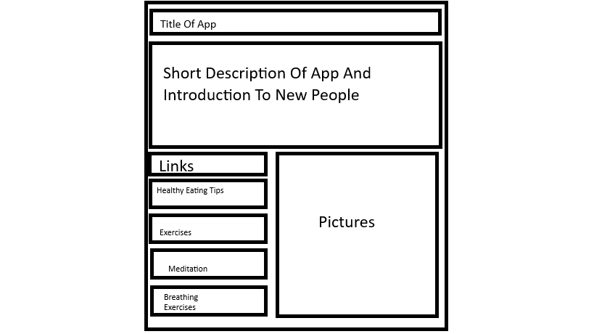
Home Page - Wireframe

Slide 4
Healthy Eating Tips - Wireframe

Slide 5
Quick Brief Of The App
Happy & Healthy is a vibrant, kid-friendly mobile app designed to help schoolchildren aged 4–16 build lifelong wellness habits through fun, guided activities and easy-to-follow routines. The app brings together four key areas of wellbeing—breathing exercises, meditation guides, exercise routines, and healthy eating advice—into one cheerful, engaging platform. With bright colors, friendly characters, and age-appropriate content, Happy & Healthy makes wellness feel exciting rather than overwhelming. Younger users can explore simple breathing exercises that teach them how to calm their minds, while older students can follow more advanced mindfulness sessions to manage stress before tests or busy school days. The meditation guides include short, soothing audios that help children refocus, boost emotional awareness, and develop inner balance. In addition, the app offers a range of exercise guides tailored to different age groups, from playful movement games for younger children to structured workouts for teens looking to stay active. To support healthy eating, Happy & Healthy includes colorful food charts, snack suggestions, and interactive meal-planning activities that help students understand nutrition in a fun and practical way. Every feature is designed with children’s safety and development in mind, ensuring instructions are clear, positive, and always supportive. Whether used at home or in school, Happy & Healthy empowers children to make healthy choices independently while giving parents and teachers helpful tools to reinforce good habits. Through daily reminders, progress badges, and encouraging feedback, the app transforms wellness into an engaging adventure that supports both the body and the mind—helping every child grow happier, stronger, and healthier every day.

