Slide 1
Uk Tourist Destinations
By Christopher Duguid

Slide 2
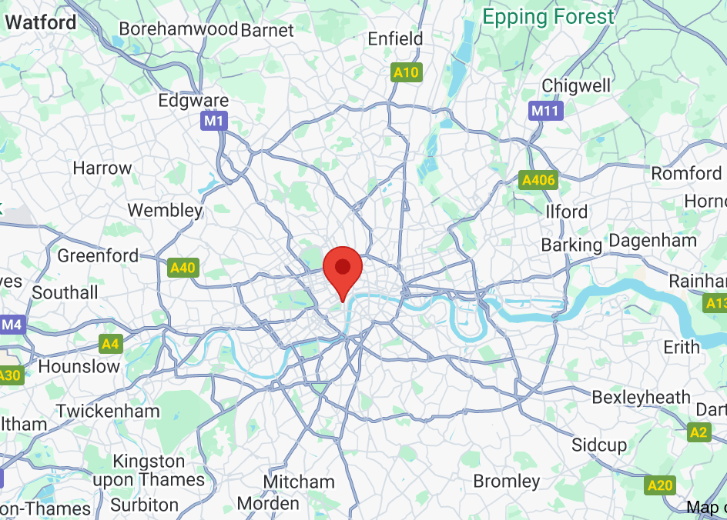


London – what it’s close to
Its also quite close to Wembley

Slide 3
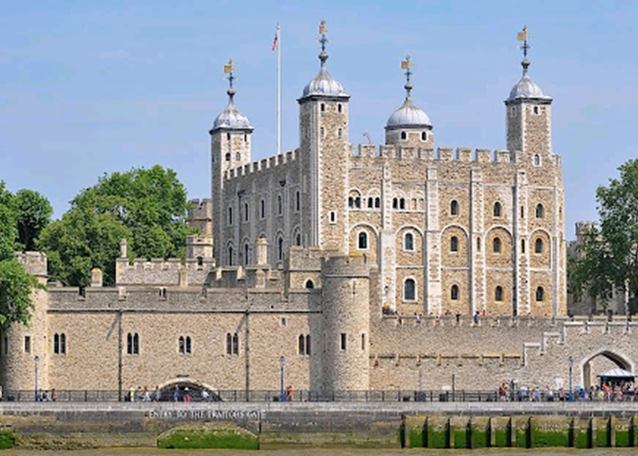

What is London famous for
London is famous for the house of parliament

Slide 4
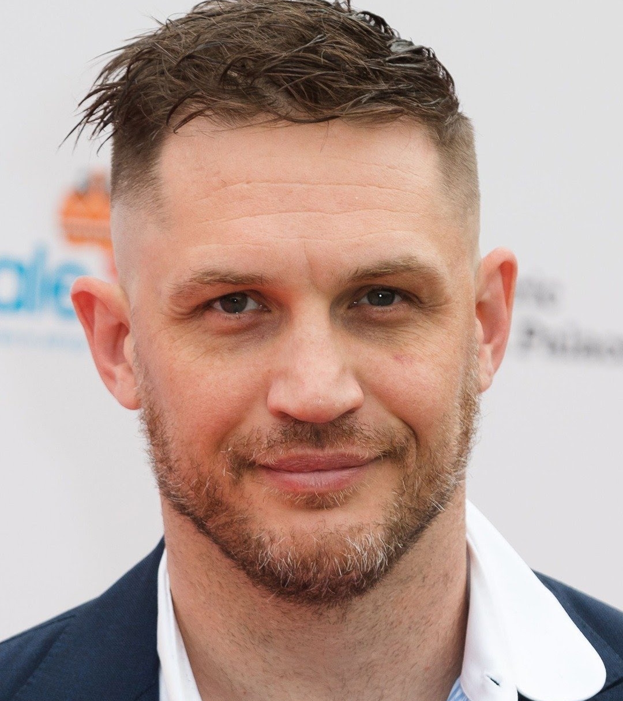
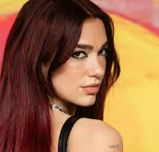
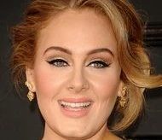
Who is famous from London
Dua lipa – singer
Tom Hardy - Actor
Adele – singer

Slide 5
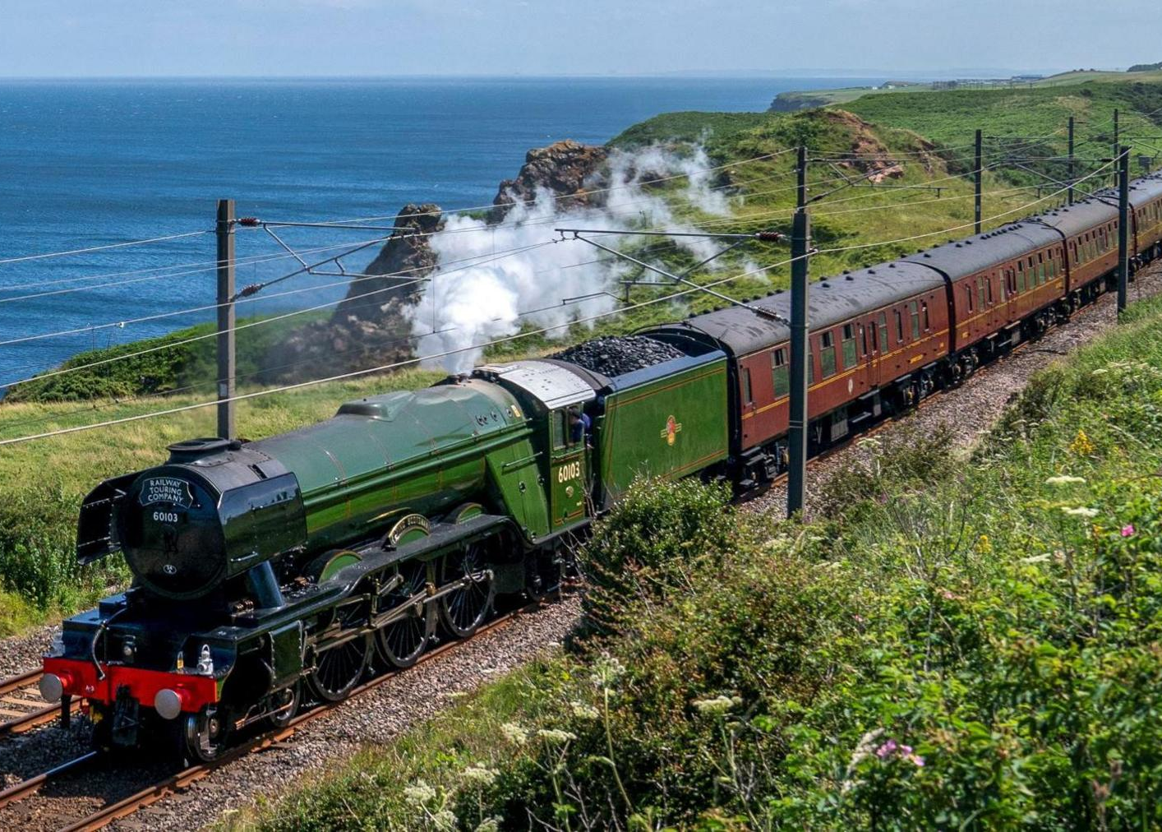
How to get to london
Train – waterloo station
Plane - London Heathrow
Car
Bus
taxi

Slide 6
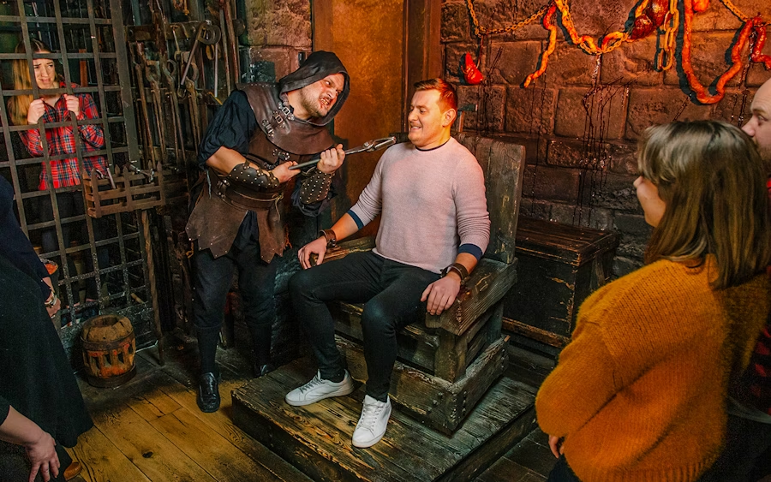
Why tourist go to London
To see Buckenham palace
the London eye
The dungeons
The river tymaes

Slide 7
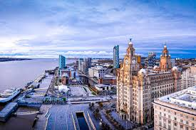
liverpool
Liverpool got its name from a tidal creek that filled up and which the two streams drained

Slide 8
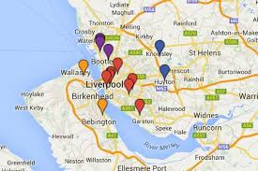
Where is Liverpool close to
Bidston
Sefton Village
Port Sunlight
Little Crosby
Meols
Frankby
Croston
Withnell Fold.

Slide 9
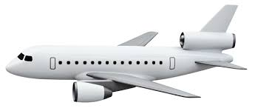
How to travel to Liverpool
Plane –Liverpool John Lennon Airport
Train – Banksdale
Car
Bus
taxi

Slide 10
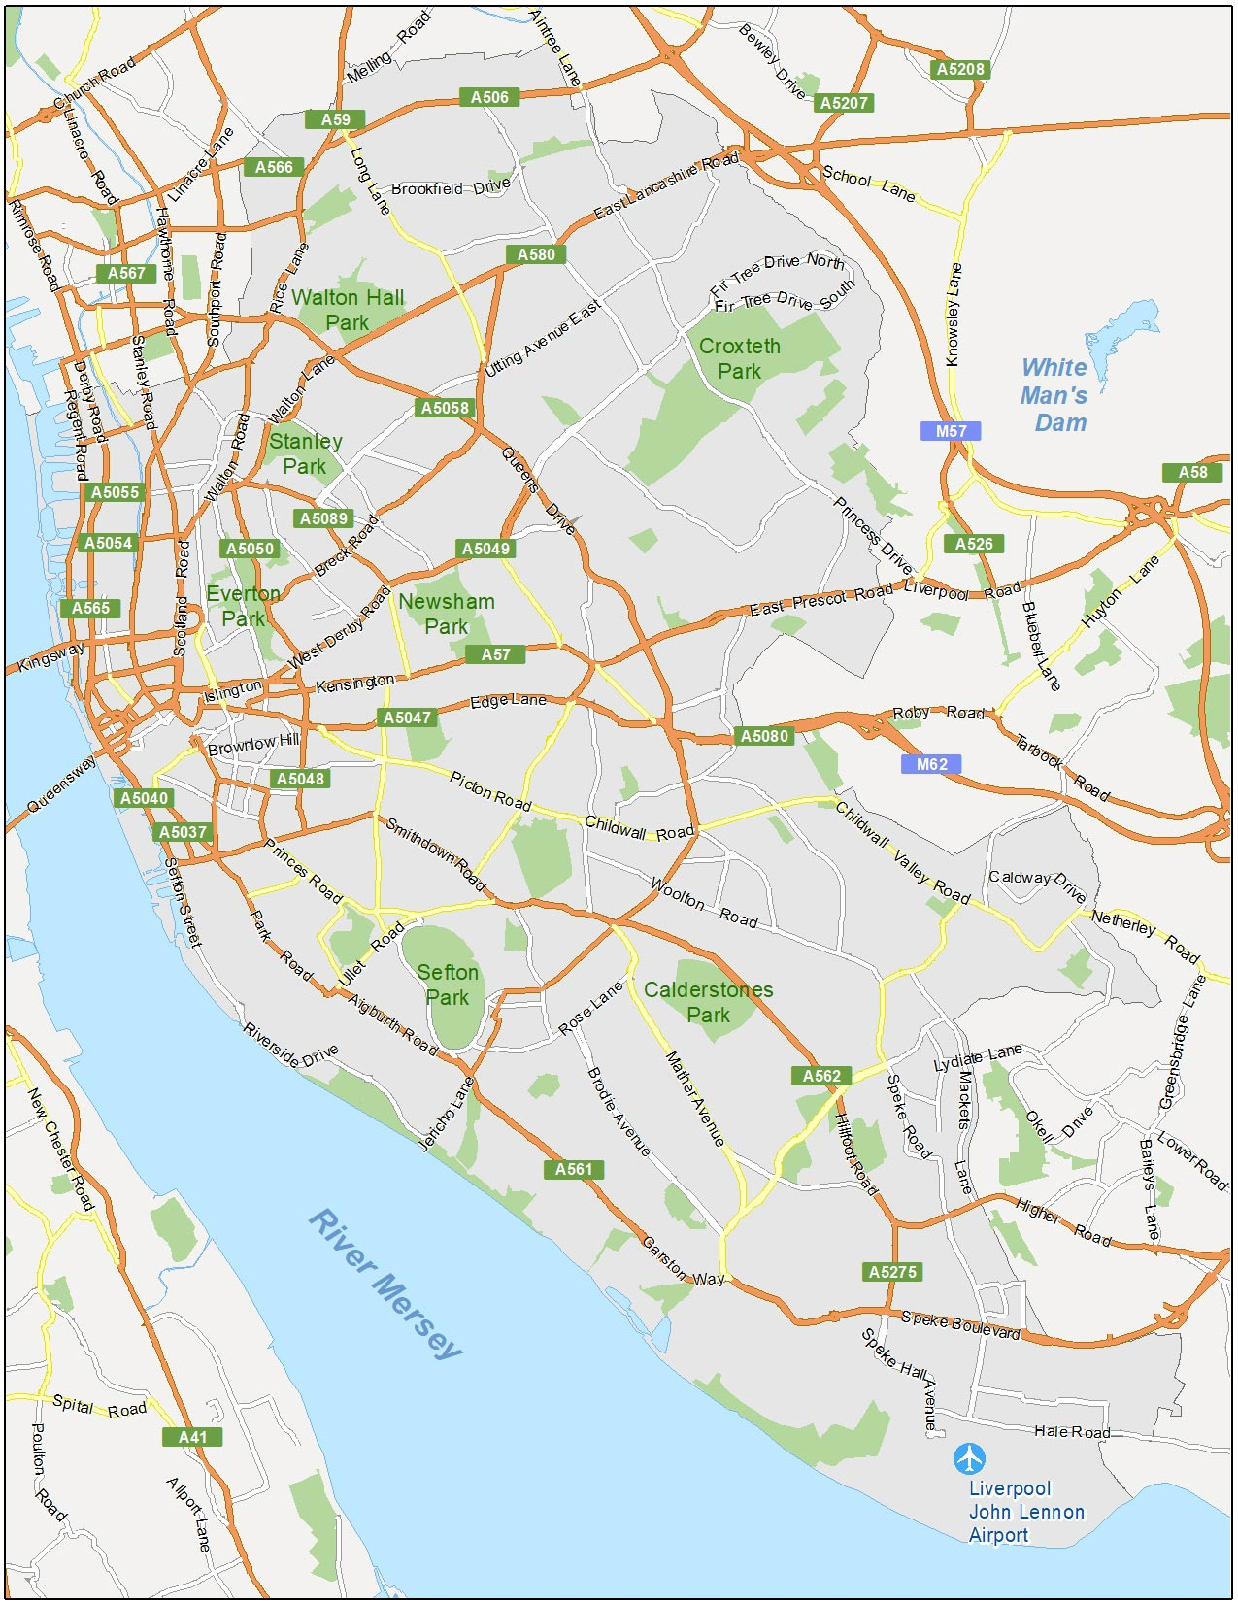




Where is Liverpool

Slide 11
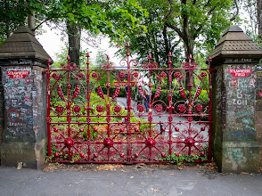
What to do in Liverpool
The Liverpool strawberry field Strawberry Field 10 am–5 pm
Breakfast 10–11:30 am
Lunch 12–3 pm
Hours

Slide 12
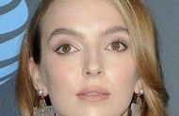
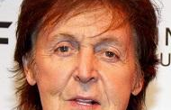
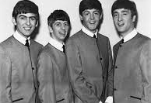
Who is famous from Liverpool
The Beatles
Paul Mcarthy
Jodie Comer

Slide 13
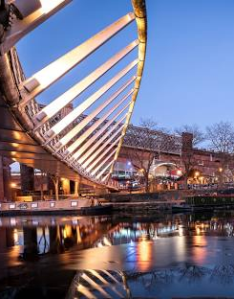
Manchester
The name Manchester comes from the Latin Mamucium or it’s variant Mancuino.

Slide 14
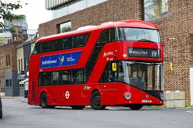
How to get to Manchester
Plane - Manchester
Train – Manchester Piccadilly
Car
Bus – Manchester bus
taxi

Slide 15
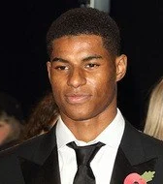
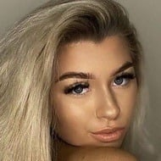
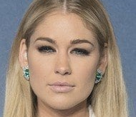
Famous people from Manchester
Marcus Rashford - footballer (obviously)
Sophie Aspin- rapper
Amanda Clapman –soap opera actress

Slide 16
Things to do in Manchester
Science museum –all week 10 am – 5pm
HOME Manchester – cinema – times are when the screening of your film starts

